Slide 1
Smart Predictive Modelling for Rental
Property Prices

Slide 2
CONTENT :
Introduction
Tools Used
Model Approach
Factors Affecting Rent
Conclusion

Slide 3
Introduction:
In the real estate industry, determining the appropriate rental price for a property is crucial for property owners, tenants, and property management companies.
Accurate rent predictions can help landlords set competitive prices, tenants make informed rental decisions, and property management companies optimize their portfolio management.
The goal of this project is to develop a data-driven model that predicts the rental price of residential properties based on relevant features. By analysing historical rental data and property attributes, the model aims to provide accurate and reliable rent predictions.

Slide 4
Technologies Used:
Programming Language: Python
Libraries: Pandas, Matplotlib, Seaborn, Scikit-learn
STREAMLIT: Streamlit library was used to create a user-friendly UI that enables users to interact with the programme and carry out data retrieval and analysis operations.
Pandas is a Python library for data manipulation and analysis, providing easy-to-use data structures like DataFrames for efficient handling of structured data in diverse projects.
Seaborn is a Python data visualization library that works in conjunction with Matplotlib, simplifying the creation of attractive statistical plots with concise syntax, making it valuable for enhancing visualizations in projects.
Matplotlib is a Python library widely used in project for creating diverse visualizations, including line plots, scatter plots, and histograms, facilitating effective data analysis and presentation.
Scikit-learn is a Python machine learning library used in project for building and deploying machine learning models, offering a wide range of tools for classification, regression, clustering, and more. It simplifies the development of predictive models with a consistent and user-friendly interface.

Slide 5
Model Approach:
Data Preprocessing: Clean and preprocess the features and historical rental prices data, handling missing values, outliers, and encoding categorical variables.
Feature Selection and Engineering: Identify key features that significantly influence rental prices. Perform feature engineering to create new informative features, such as proximity scores to important facilities.
Model Selection: Choose appropriate regression algorithms for the task, such as linear regression, decision trees, random forests, gradient boosting, or neural networks. Consider ensembling or stacking multiple models for improved performance.
Model Training and Evaluation: Split the dataset into training and testing sets. Train the selected models on the training data. Evaluate model performance using appropriate metrics (e.g., mean squared error, mean absolute error) on the testing data.

Slide 6
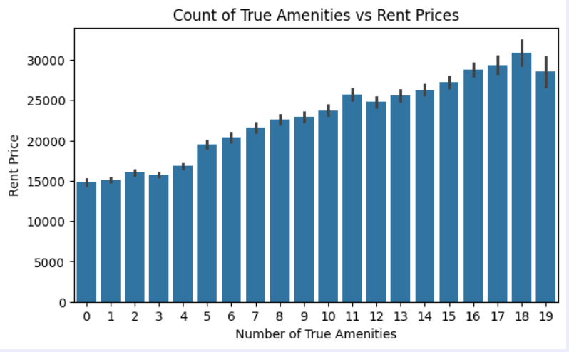
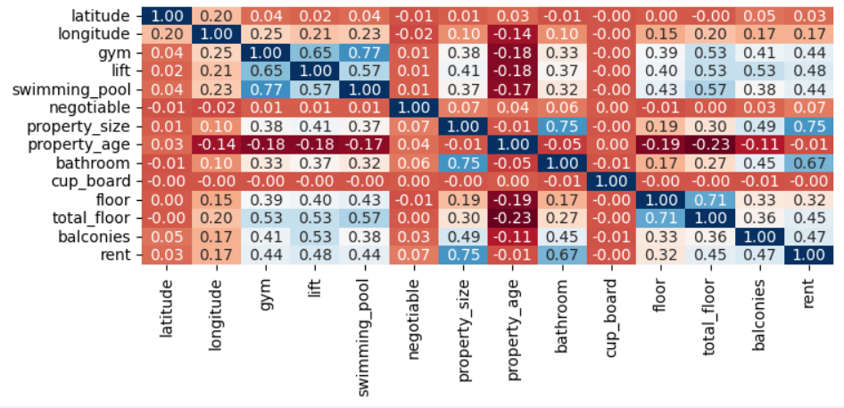
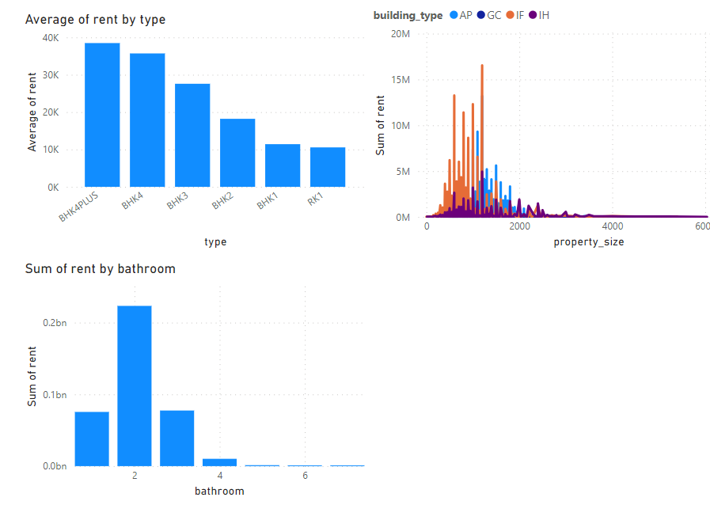
FACTORS AFFECTING RENT:

Slide 7
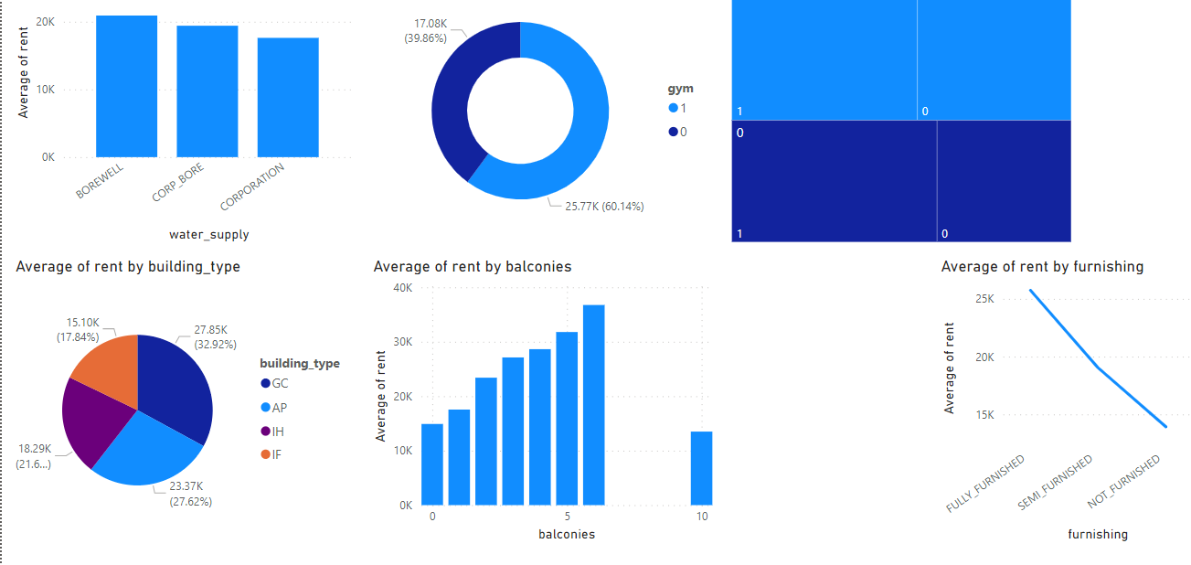

Slide 8
As the number of rooms increases, the rent tends to rise.
Fully furnished houses command higher rent prices.
Properties equipped with a borewell generally have higher rental rates.
Houses featuring 2 bathrooms are associated with higher rents.
An increment in the number of balconies is correlated with an increase in rent.
Additionally, an augmentation in amenities is linked to higher rental costs.

